Slide 1

Week 5
User Experience: Structure
1

Slide 2
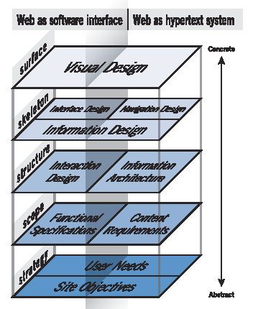
UX Design - Structure
Source: Garrett, 2002
2

Slide 3



The focus of IxD is on user behaviour and on satisfying user needs.
Interaction Design (IxD)
It uses goal-oriented design (aka goal directed design) to underpin the way it looks at how users interact with the software or a device.
Specifically, it is interested in how the interaction can enable the most effective way of satisfying the user’s needs.
3

Slide 4

IxD - Definition
Interaction design is the art of facilitating or instigating interactions between humans (or their agents), mediated by products.
Interactions mean communication:
One-on-One: Examples include a phone call or a face-to-face conversation.
One-to-Many: This includes platforms like blogs or social media where one individual communicates with a larger audience.
Many-to-Many: Examples include dynamic environments like the stock market, where multiple participants engage in interactions simultaneously.
The products an interaction designer creates can be digital or analog, physical
or virtual or some combination thereof.
IxD is about creating products or systems that help people communicate and interact with each other or with the product itself. It focuses on how users engage with things like websites, apps, or even physical devices.
Derived from Dan Saffer (2004) http://www.odannyboy.com/blog/archives/001000.html
4

Slide 5
IxD - Definition
IxD is not about:
Industrial Design: Which centers on the design of physical products and their usability.
Human-Computer Interaction (HCI): Which specifically addresses interactions between users and computer systems.
It's about making connections between people.
Derived from Dan Saffer (2004) http://www.odannyboy.com/blog/archives/001000.html

Slide 6

Effective IxD
Effective interfaces are visually apparent and forgiving, instilling in their users a sense of control. Users quickly see the breadth of their options, grasp how to achieve their goals, and do their work.
Effective interfaces do not concern the user with the inner workings of the system. Work is carefully and continuously saved, with full option for the user to undo any activity at any time.
Effective applications and services perform a maximum of work, while requiring a minimum of information from users.
Bruce Tognazzi: http://www.asktog.com
6

Slide 7
Principles of Interaction Design
Aesthetics
Prioritize usability over fashion.
Leave the aesthetic details primarily to graphic designers.
Anticipation
Provide users with all the necessary tools they may need.
Autonomy
Empower users to make their own decisions.
Colour
Utilize clear secondary hues and be mindful of colour blindness when selecting colours.
Consistency
Maintain both consistency across the wider web and within your website.
Defaults
Set intelligent and responsive defaults for user inputs.
Source http://www.asktog.com/basics/firstPrinciples.html

Slide 8
Principles of Interaction Design
Discoverability
Avoid hiding helpful features, as this can make the user experience more complicated.
Efficiency of the User
Keep users engaged, rather than keeping the computer occupied.
Explorable Interfaces
Provide well-marked paths and landmarks and allow for reversible actions for better exploration.
Fitts’s Law
Understand that the time to acquire a target is related to its distance and size.
Human-Interface Objects
Design elements such as folders, menus, and buttons should be perceivable through sight, sound, touch, or other senses.
Source http://www.asktog.com/basics/firstPrinciples.html

Slide 9
Principles of Interaction Design
Latency Reduction
Minimize latency wherever possible to enhance user experience.
Learnability
Aim to limit trade-offs between usability and learnability.
Metaphors
Use visual metaphors to make concepts easily understandable for users.
Protect Users’ Work
Ensure that users never lose their work due to errors.
Source http://www.asktog.com/basics/firstPrinciples.html

Slide 10
Principles of Interaction Design
Readability
Use high-contrast colours and legible fonts for easy reading.
Simplicity
Achieve a balance between ease of installation and overall ease of use.
State: Track It
Securely store session details (e.g., via encryption).
Visible Interfaces
Ensure navigation elements are visible to users.
Source http://www.asktog.com/basics/firstPrinciples.html

Slide 11
IxD Techniques – Cognitive Dimensions
Using Cognitive Dimensions in interaction design helps create systems that align with users' thinking and learning styles, resulting in a more intuitive user experience and improved usability. Key principles include:
Visibility: The ease of finding features and options.
Consistency: Maintaining uniformity across elements.
Errors: The design's ability to help users recover from mistakes.
Affordance: Indicating how objects can be used.
Mapping: The relationship between controls and their outcomes.
Explorability: Allowing users to learn the system without confusion.
Feedback: Providing clear responses to user actions.

Slide 12
IxD Process Wireframes
Built upon Site Objectives, User Needs, Functional Specification and Content Requirements.
Combine these into Prototype Designs of the Interaction using Wireframes.
A website wireframe is used to map out the main features and navigation of a new website design. It gives an idea of the site's functionality before considering visual design elements, like content and colour schemes.
Layouts and features such as menus and buttons are mapped out to assess the overall experience of the end user.
A website wireframe also provides a practical map of the project for team members to see where everything will go as they complete related tasks.
10

Slide 13
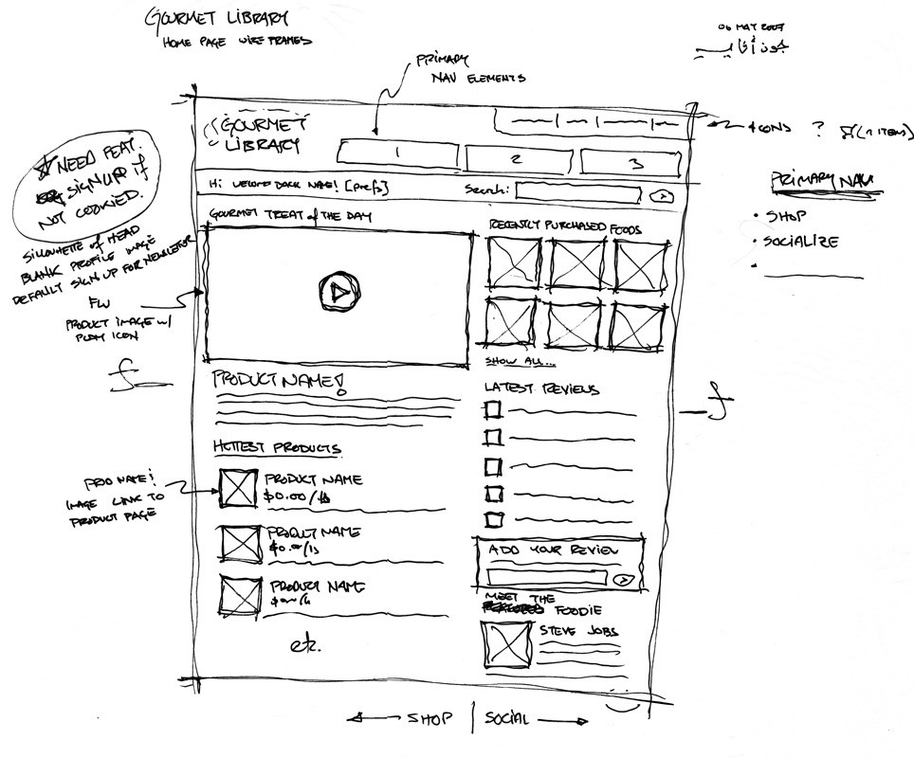
Wireframe
Source: https://uk.pinterest.com/yuichiandou9/website-wireframe/

Slide 14
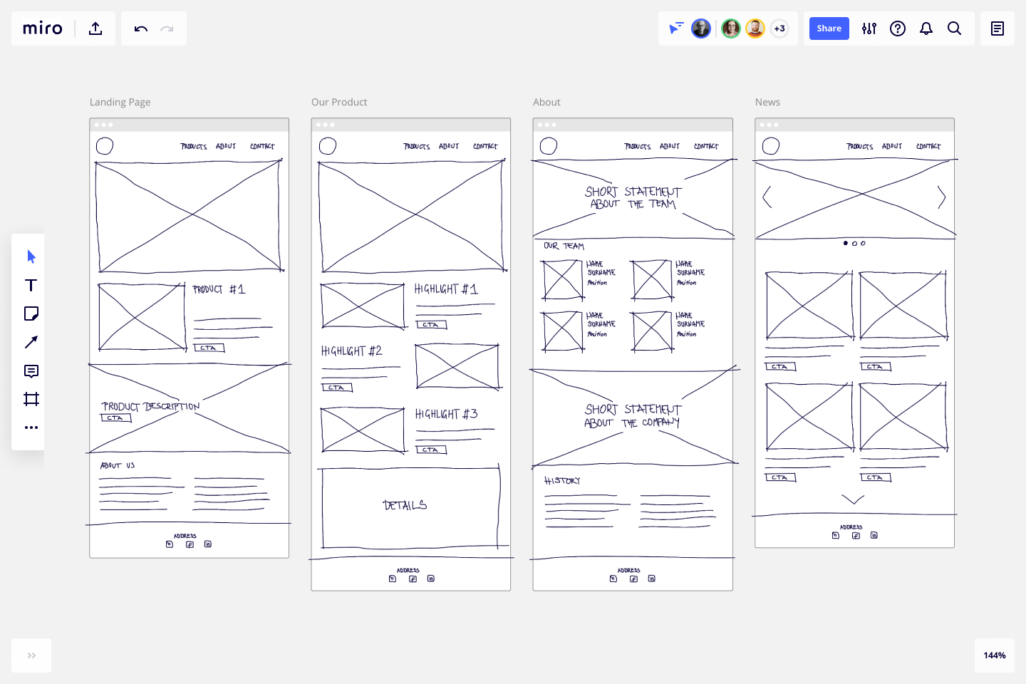
Wireframe
Source: https://miro.com/templates/low-fidelity-wireframes/

Slide 15
Outputs and Testing
At this stage of the design process the main tests are usability tests, at this stage the tests conducted are what are called Low Fidelity/LoFi tests.
These will be covered in the Usability lecture, but if you are interested read here:
Usability Testing 101
https://www.nngroup.com/articles/usability-testing-101/
A novice designer’s guide to usability testing
https://uxplanet.org/a-novice-designers-guide-to-usability-testing-177bcddc57b3
12

Slide 16
IxD Case Studies
The iPhone
Everything is a Remix Case Study: The iPhone
https://www.youtube.com/watch?v=xPzpIRZAWUc

Slide 17
Part 2
Information Architecture
15

Slide 18
Information Architecture
“We define information architecture as the art and science of organizing and labelling websites, intranets, online communities and software to support usability.” Information Architecture Institute
Information architecture is the term used to describe the structure of a system, i.e. the way information is grouped, the navigation methods and terminology used within the system.
An effective information architecture enables people to step logically through a system confident they are getting closer to the information they require.
Most people only notice information architecture when it is poor and stops them from finding the information they require.
Ian Barker at Two Steps Design
http://www.steptwo.com.au/papers/kmc_whatisinfoarch/index.html

Slide 19
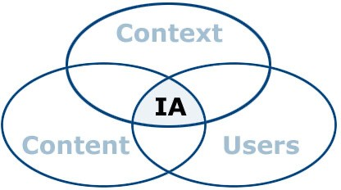
Information Architecture
Louis Rosenfeld and Peter Morville defined the 'three circles of information architecture' as content, users and context of use.
From: Rosenfeld, Louis, and Peter Morville. I, third edit information Architecture for the World Wide Webon. Sebastopol, California: O‘Reilly & Associates, 2006.
Context = business goals, funding, politics, culture, technology, resources, constraints
Content = content objectives, document and data types, volume, existing structure, governance and ownership
Users = audience, tasks, needs, information-seeking behaviour, experience

Slide 20
Styles of Information Architecture
There are two main approaches to defining an information architecture. These are:
Top-down information architecture This involves developing a broad understanding of the business strategies and user needs, before defining the high-level structure of site, and finally the detailed relationships between content.
Bottom-up information architecture This involves understanding the detailed relationships between content, creating walkthroughs (or storyboards) to show how the system could support specific user requirements and then considering the higher-level structure that will be required to support these requirements.

Slide 21
Styles of Information Architecture
Both of these techniques are important in a project.
A project that ignores top-down approaches may result in well-organised, findable content that does not meet the needs of users or the business.
A project that ignores bottom-up approaches may result in a site that allows people to find information but does not allow them the opportunity to explore related content.

Slide 22
Creating an Effective Information Architecture
The following steps define a process for creating an effective information architectures.
Understand the business/contextual requirements and the proposed content for the system. In other words, re-check the site objectives, User needs and Content Requirements.
Group and Label the Content. Conduct cards sorting exercises with a number of representative users. Look for trends in grouping and labelling.
Define the Navigation and Sitemap. Develop a draft information architecture (i.e., information groupings and hierarchy). Groups and labels will be combined with the IA to be the basis of menus and sitemaps.
Content Matrix
User Testing
20

Slide 23
Card Sorting
In a card sorting session, participants organize topics into categories that make sense to them. To conduct a card sort, you can use actual cards, pieces of paper, or one of several online card-sorting software tools such as:
Optimal Sort - Online Card Sorting Tool | Optimal Workshop
This can be useful for organising either:
Products in an e-commerce store
Organising FAQ questions
Untangling a site map
Etc.
21

Slide 24
Creating an Effective Information Architecture
Document the information architecture in a site map. This is not the final site map - the site map will only be finalised after page layouts have been defined to inform search engines about the URLs that are available for web crawling.
Define a number of common user tasks, such as finding out about how to request holiday leave. On paper sketch page layouts to define how the user will step through the site. This technique is known as storyboarding.
22

Slide 25
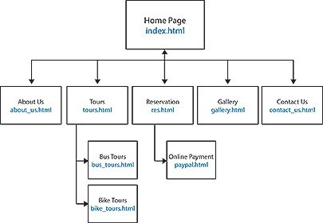
Sitemap
Source: http://digestwebdesign.com/sitemap.html
26

Slide 26
Storyboarding
You will likely have heard of storyboarding from film, but you can also use storyboarding for UX design, illustrating a specific scenario that a user may take. Storyboards will be built up with the following components:
A scenario – what it is the user is going to do on your site.
A user – this can be one of your personas you made prior.
Visuals – made up of several difference frames showing how the user will complete the scenario.
Text – a description of each frame, elaborating on what is happening.
26

Slide 27
Storyboarding
When storyboarding, follow the seven steps:
Define the purpose of your storyboard – a common scenario.
Compile needed data – user research data like interviews or tests.
Prepare the tools – pen & paper or digitally.
Craft the scenario and choose the user/persona.
Draft the story in writing first.
Illustrate the visuals and write the accompanying descriptions.
Present the storyboard to peers.
27

Slide 28
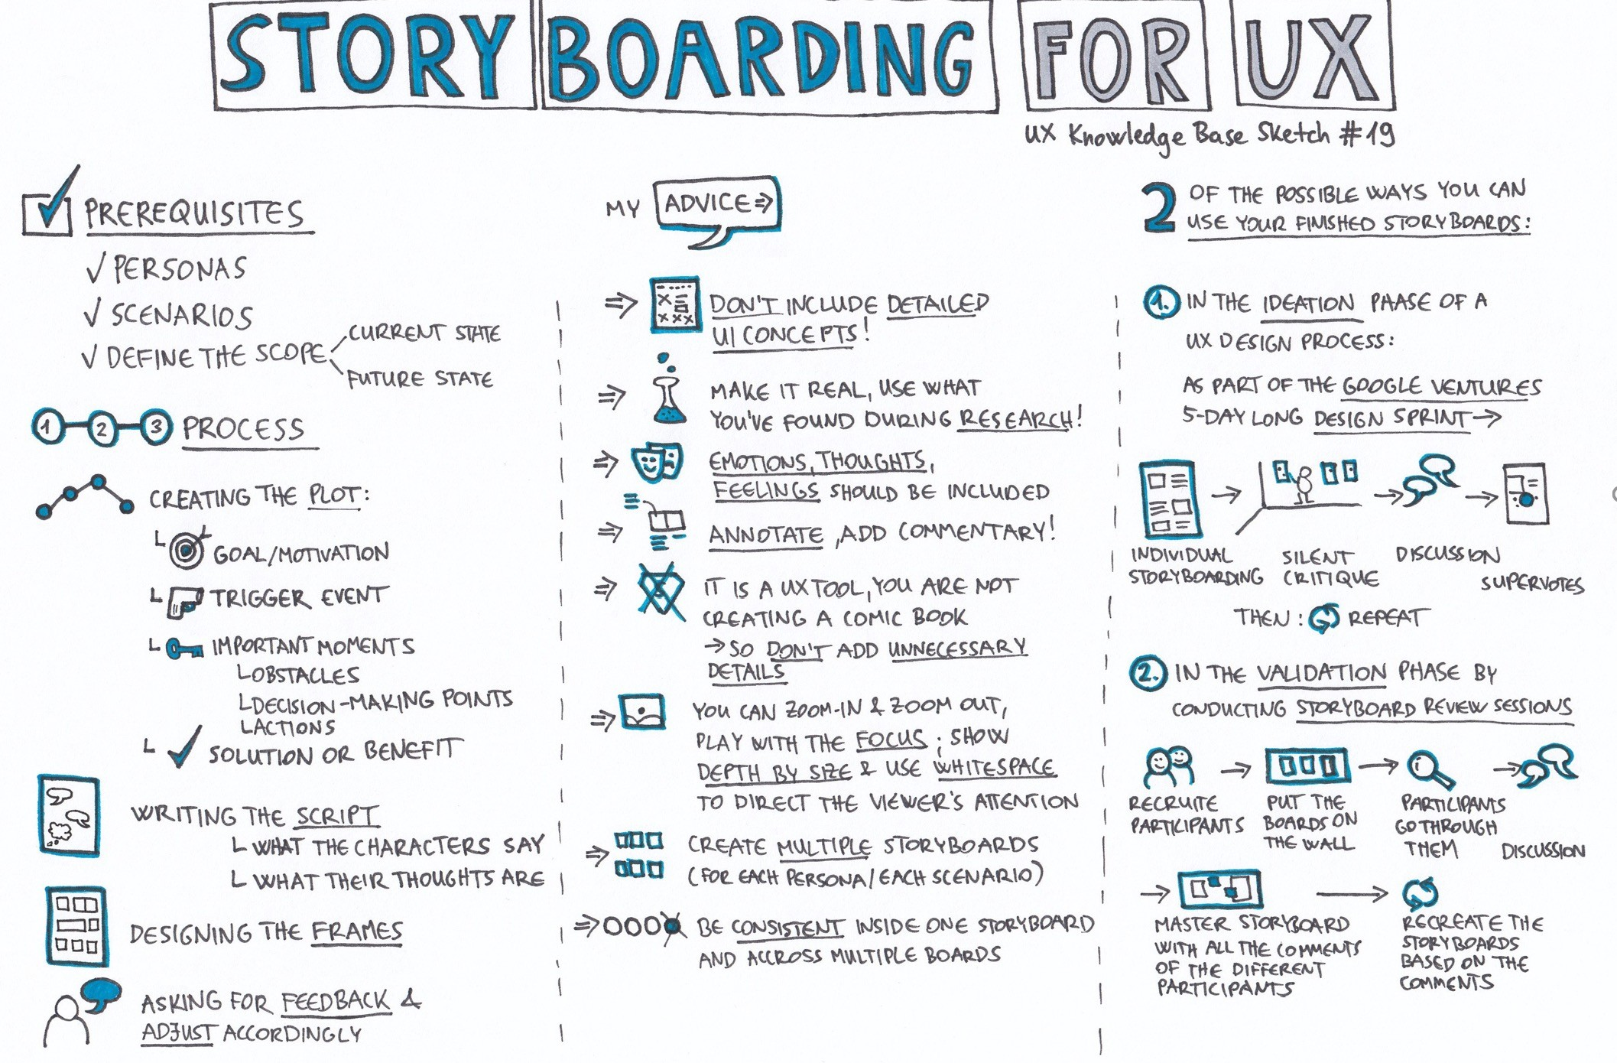
Storyboarding Process
Source: https://uxknowledgebase.com/ storyboarding-part-2- 1de031e5fd06
Storyboard - key outcome of IA design
28

Slide 29
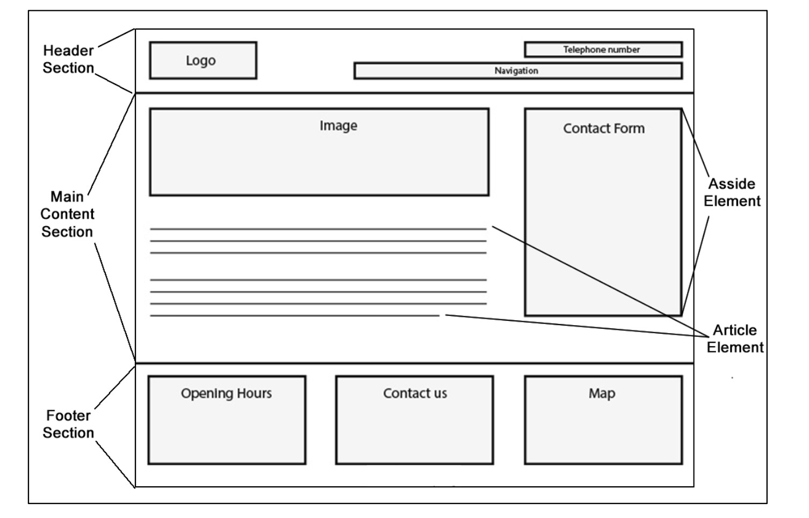
Storyboard
Source: https://www.sampletemplates.com/business-templates/website-storyboard.html

Slide 30
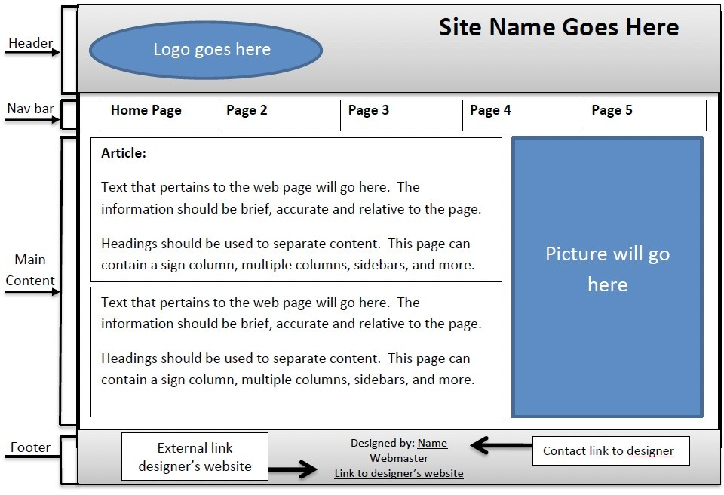
Testing an Effective Information Architecture
Walk other members of the project team through the storyboards.
If possible, within the constraints of the project, it is good to conduct task-based usability tests on paper prototypes as it provides valuable feedback without going to the expense of creating higher quality designs.
Create detailed page layouts to support key user tasks. Page layouts should be annotated with guidance for visual designers and developers.
https://www.sampletemplates.com/business-templates/website-storyboard.html
28

Slide 31
Content Matrix
A content matrix lists each page in the system and identifies the content that will appear on that page and groups them.
A content audit is the starting point of assessing content, whereas the content matrix is a living record of your content that can evolve in the future.
29

Slide 32
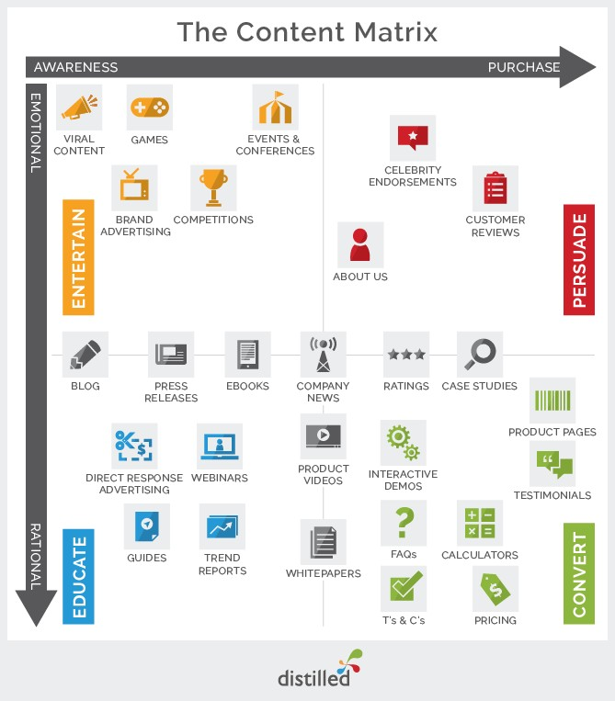
Content Matrix
Source:
https://www.distilled.net
30

Slide 33



Outputs of the Information Architecture Process
STORYBOARDS
SITEMAPS (PROTOTYPES)
CONTENT MATRICES
32

Slide 34


Reading
Bill Moggeridge Interview on how he started thinking about IxD
http://www.designinginteractions.com/download
Web Navigation Design
https://www.oreilly.com/library/view/designing-web-navigation/9780596528102/
Information Architecture Tutorial
https://www.wired.com/2010/02/information-architecture-tutorial-lesson-1/
Useful Chapter on IxD
http://www.alandix.com/academic/teaching/rome2003/docs/rome-ch05.pdf
Examples of IxD tools
https://bradley-nice.medium.com/best-interaction-design-tools-4af01e259959
33

